Slide 1

Digital Egypt Pioneers Initiative (DEPI)
AI in Healthcare Diploma · Graduation Project
KIDCARE
Doctor-approved AI support for families of children with asthma and type 1 diabetes
Team
Under the supervision of
Asmaa Mohamed Mohamed Ramadan
Ayah Mohamed Zaki Shabana
Esraa Mostafa Attia Zaghlal
Nada Hamdy Mohamed Osman
Noha Essam Abdelrahman Mohamed Yaseein
Eng. Mohammed Anas
Notes:
Dr. Ayah opens. Greet the audience, thank DEPI and Eng. Mohammed Anas, introduce the team in one sentence, then go straight into the story.
1

Slide 2

Dr. Ayah · Introduction
A story
It’s 10 pm in Cairo
Salma is 9. Three months ago, she was diagnosed with type 1 diabetes.
Tomorrow is her first school trip. Her mother, Mariam, has questions: What should Salma eat on the trip? What should the teacher know?
Mariam and Salma are a fictional family, based on everyday situations.
Notes:
Tell this slowly, like a real story. Pause after “Mariam has questions”. Every parent in the room knows this feeling.
2

Slide 3



Dr. Ayah · Introduction
A story
What can Mariam do tonight?
Wait
Search online
Ask a chatbot
The next clinic visit is in three weeks.
She finds advice that disagrees with itself.
It answers fast, but no doctor checks the answer.
Too slow
Not reliable
Not checked
Nothing tonight is both fast and safe.
Notes:
Three options, three problems. End on the last line: fast and safe at the same time is what is missing.
3

Slide 4




Dr. Ayah · Introduction
A story
With KIDCARE
1. Mariam fills a short form
2. A doctor checks the answer
3. The answer arrives by email
Six simple questions, from her phone.
The system prepares it. A doctor approves it.
Clear, safe, and written for Salma’s condition.
Fast for Mariam. Safe for Salma. Easy for the doctor.
Notes:
This is the promise of KIDCARE in three steps. The rest of the presentation shows how each step is built.
4

Slide 5



Dr. Ayah · Introduction
The need
Families like Mariam’s are many
1 in 11
≈ 69,000
0.75
children and teenagers in Egypt has asthma
children and teenagers in Egypt live with type 1 diabetes
doctors for every 1,000 people in Egypt
Sources: Taherian et al., BMC Public Health 2024; IDF Diabetes Atlas, Egypt 2024; WHO Global Health Workforce Statistics 2019
Notes:
Mariam is not alone. About 1 in 11 Egyptian children and teens has asthma, and about 69,000 live with type 1 diabetes. Both are lifelong, managed at home every day. And there are only about 0.75 doctors for every 1,000 people. The questions are many; the doctors are few.
5

Slide 6


Dr. Ayah · Introduction
Our idea
Why KIDCARE is a good idea
For families
For doctors
For clinics
Fast, safe answers at home, for their child’s condition.
They check a ready draft instead of writing every reply.
They support more families with the same staff.
The AI prepares. The doctor decides.
Notes:
Three groups win at once. And the safety rule that runs through the whole system: the AI prepares, the doctor decides.
6

Slide 7

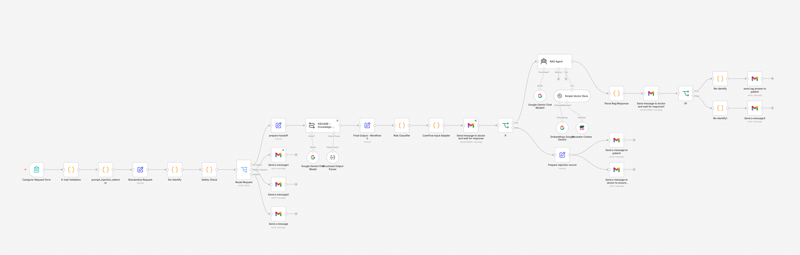
Introduction
The workflow
Our workflow in n8n
34 nodes
1 connected system
2 doctor approvals
Notes:
This is the real workflow. It reads left to right: the form, the checks, the AI summary, the doctor, the medical knowledge, and the emails back to the family. Each of us now explains our part, node by node.
7

Slide 8
Introduction
The team
Five parts, five presenters
Part 1 · Nodes 1–9
Part 2 · Nodes 10–11
Part 3 · Nodes 12–15
Part 4 · Nodes 16–19
Part 5 · Node 20 +
Dr. Ayah
Dr. Noha
Dr. Asmaa
Dr. Nada
Dr. Esraa
Introduction, intake and protection
The AI case summary
Risk and medical knowledge (RAG)
Doctor review and caregiver communication
Safety, monitoring and evaluation
Notes:
Introduce who presents what. Explain the pattern: every node gets one slide for the business view and one for the technical view.
8

Slide 9
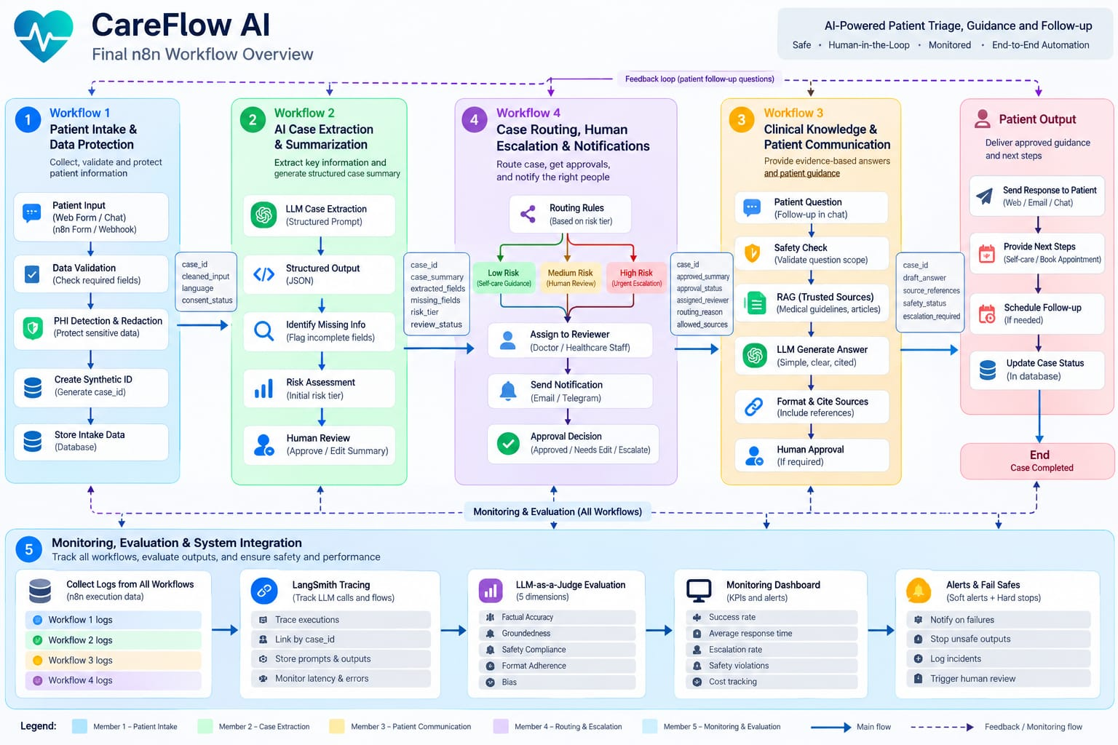

Slide 10
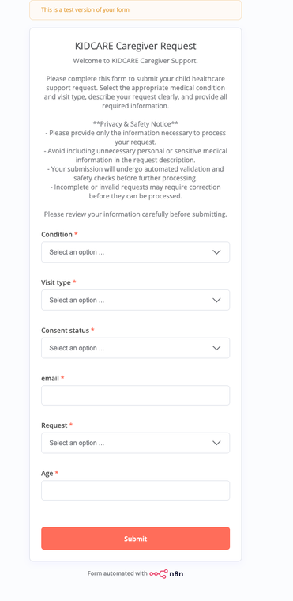
Dr. Ayah · Part 1
Node 1 · What it does
Caregiver Request Form
This is what Mariam sees: a short form with six questions.
  Condition: asthma or diabetes
  Visit type and request type
  Consent, email and the child’s age
Why it matters: set choices make every request easy to sort, and a privacy notice asks families to share only what is needed.
Notes:
Show the real form. Every field is required. The privacy notice at the top tells families not to share unnecessary personal details.
9

Slide 11
Dr. Ayah · Part 1
Node 1 · How it works
Inside the form
// one submission (synthetic example)
{
"Condition": "Diabetes",
"Visit type": "Education",
"Consent status": "Granted",
"email": "family@example.com",
"Request": "life-style recommendation",
"Age": 9
}
n8n node
Form Trigger
Starts
The whole workflow, on every submission
Fields
6, all required: 4 drop-downs, an email field and a number
JSON: the data format n8n passes from one node to the next.
Notes:
A trigger node is the starting point of a workflow. Here, each time a caregiver presses Submit, n8n receives the answers as one JSON item and passes it to node 2.
10

Slide 12
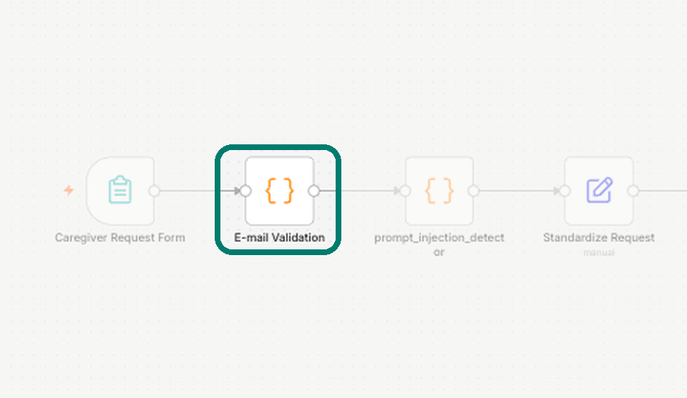
Dr. Ayah · Part 1
Node 2 · What it does
E-mail Validation
Checks that the email address is written correctly.
Why it matters: the doctor-approved answer must reach the right family.
Notes:
A simple step, but every reply depends on it.
11

Slide 13
Dr. Ayah · Part 1
Node 2 · How it works
Inside E-mail Validation
const emailRegex =
/^[A-Za-z0-9._%+-]+@[A-Za-z0-9.-]+\.[A-Za-z]{2,}$/;
const email = String(item.json.email ?? '').trim();
return {
json: {
...item.json,
email,
emailValid: emailRegex.test(email)
}
};
n8n node
Code (JavaScript)
Adds
emailValid: true or false
Runs
Before any AI step
Notes:
A regular expression (regex) is a pattern for text. This one accepts “name@domain.ext” and rejects anything else. The result is saved in a new field, emailValid.
12

Slide 14
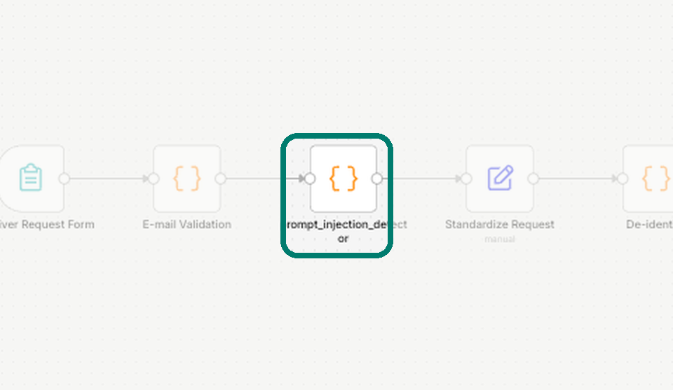
Dr. Ayah · Part 1
Node 3 · What it does
Prompt-injection detector
Looks for hidden commands that try to trick the AI, like “ignore your rules”.
Why it matters: attacks are caught before the AI ever reads the request.
Notes:
Prompt injection means hiding instructions in user text to change what an AI does. We screen for it at the door.
13

Slide 15
Dr. Ayah · Part 1
Node 3 · How it works
Inside the injection detector
const suspiciousPatterns = [
/ignore\s+(all\s+)?previous\s+instructions/i,
/reveal\s+(your\s+)?(system\s+)?prompt/i,
/forget\s+(all\s+)?(your\s+)?instructions/i,
/jailbreak/i,
// … 10 patterns in total
];
injectionStatus: injectionDetected
? 'BLOCK'
: 'ALLOW'
n8n node
Code (JavaScript)
Checks the fields
request, message, description, question, notes
Used later
BLOCK stops the case at the Risk Classifier (node 12)
Notes:
Each pattern is a regular expression; /i means upper or lower case both match. The node also saves which patterns matched (injectionMatches), useful for the log.
14

Slide 16
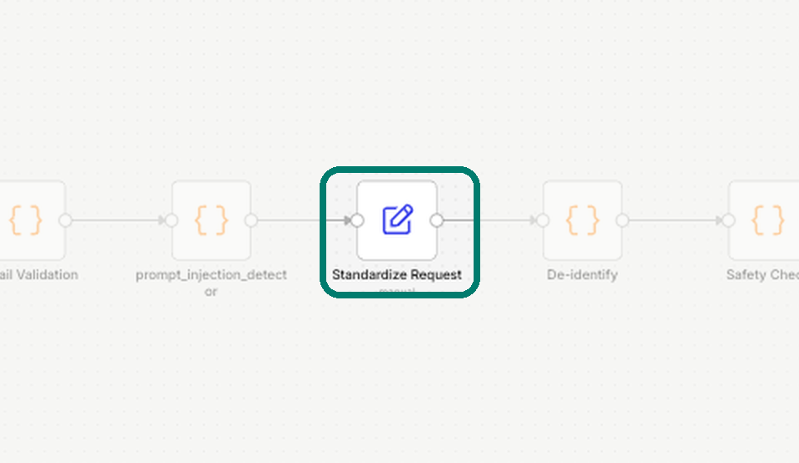
Dr. Ayah · Part 1
Node 4 · What it does
Standardize Request
Gives every request a case number and puts all answers in one clean format.
Why it matters: every later step reads the same fields, so nothing is lost or misread.
Notes:
Like a hospital file number: from here on, every step talks about the same case ID.
15

Slide 17
Dr. Ayah · Part 1
Node 4 · How it works
Inside Standardize Request
// case_id expression
KC-{{ $now.toFormat('yyyyLLdd') }}-{{ 6 random }}
// output (synthetic example)
case_id: "KC-20261029-X7Q2LM"
condition: "Diabetes"
visit_type: "education"
consent_status: "granted"
request_type: "life_style_recommendation"
patient_age: 9
safety_status: "pending"
n8n node
Edit Fields (Set)
Cleans
Trims spaces, lower case, spaces become “_”
Keeps
All earlier fields (emailValid, injectionStatus)
Notes:
An expression is the code inside {{ }} that n8n works out for each item. $now is the current date, so every case ID starts with today’s date.
16

Slide 18
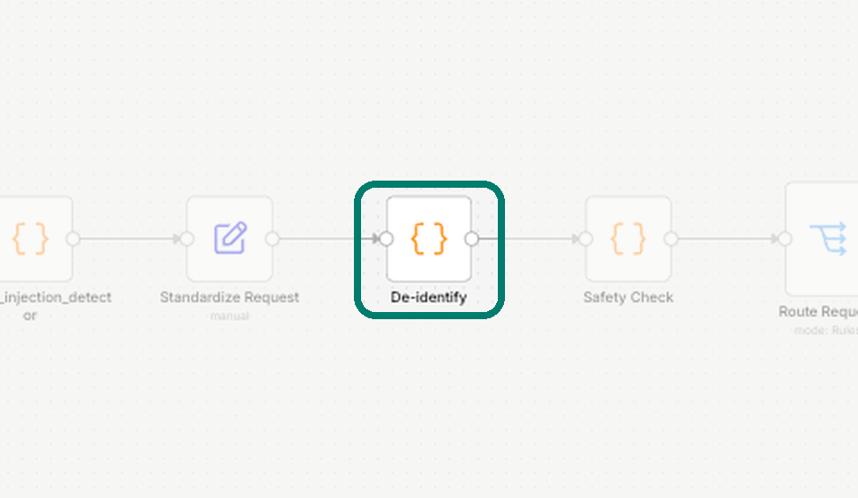
Dr. Ayah · Part 1
Node 5 · What it does
De-identify
Hides the family’s email address before any AI step.
Why it matters: privacy first. The AI does not need to know who the family is.
Notes:
De-identification means removing details that point to a real person. This is our privacy gate.
17

Slide 19
Dr. Ayah · Part 1
Node 5 · How it works
Inside De-identify
// Hide the patient’s email address
if (data.email && String(data.email).trim() !== '') {
data.email = '[EMAIL_REDACTED]';
}
return {
json: { ...data, emailRedacted: true }
};
n8n node
Code (JavaScript)
After this node
The AI only sees “[EMAIL_REDACTED]”
The real email
Read only by the email nodes, straight from the form
Notes:
The email nodes use $('Caregiver Request Form') to read the original address, so replies still reach the family while the AI never sees it.
18

Slide 20
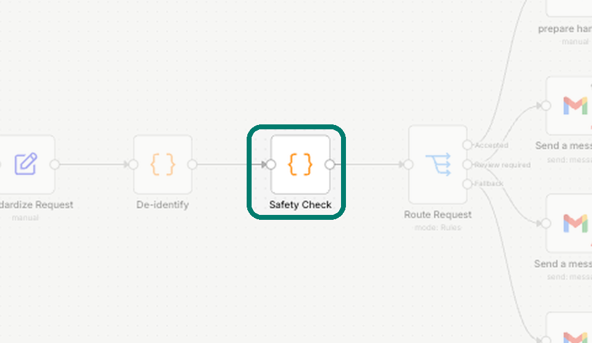
Dr. Ayah · Part 1
Node 6 · What it does
Safety Check
Raises a flag for missing consent, a phone number, an urgent symptom or a request to change a medicine.
Why it matters: anything risky goes to a doctor, not to the AI.
Notes:
Think of it as triage at the door: a flag means “a person should look at this first”.
19

Slide 21
Dr. Ayah · Part 1
Node 6 · How it works
Inside Safety Check
const flags = [];
// 6 checks, each one can add a flag:
possible_email
possible_phone
consent_not_granted
suspicious_instruction
possible_urgent_symptom
medication_change_request
safety_status = flags.length > 0
? 'review_required'
: 'basic_checks_passed';
n8n node
Code, run once for each item
Urgent words
can’t breathe, blue lips, seizure, emergency …
Medicine words
stop, double, change + dose, insulin, inhaler …
Notes:
Each check is a pattern on the request text. If any flag is raised, safety_status becomes review_required and the next node sends the case to a doctor.
20

Slide 22
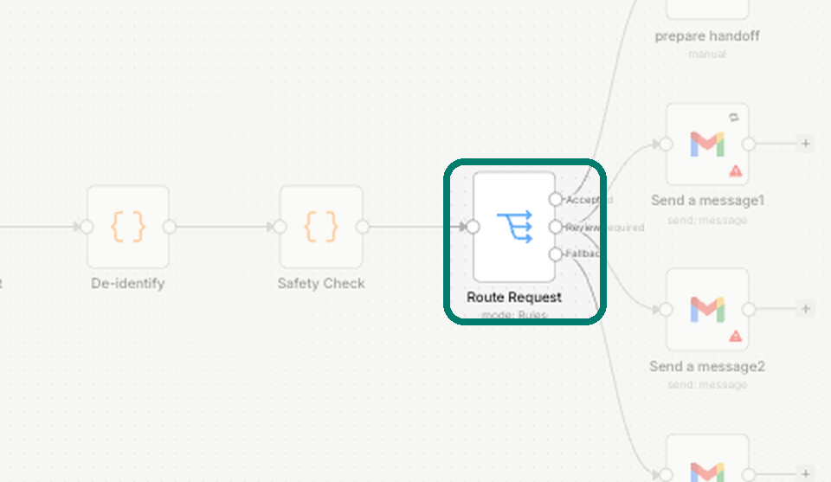
Dr. Ayah · Part 1
Node 7 · What it does
Route Request
Chooses one of three paths for each request:
Accepted → on to the AI
Review required → to a doctor
Stopped → the family is told why
Why it matters: only clean, consented questions reach the AI.
Notes:
This is the main decision point of Part 1. Emergencies and medicine questions never go to the AI; they go to a doctor.
21

Slide 23
Dr. Ayah · Part 1
Node 7 · How it works
Inside Route Request
// Output 1 · Accepted (all must be true)
consent = granted
visit = follow_up or education
request = disease info or lifestyle
safety_status = basic_checks_passed
// Output 2 · Review required (any one)
visit = medication_support
request = emergency or medication question
safety_status = review_required
// Output 3 · Fallback = Stopped
n8n node
Switch (Rules mode)
Outputs
3, one per path
Fail-safe
Anything that matches no rule is stopped, not sent on
Notes:
A Switch node is like an IF with several outputs. The Fallback output catches everything else, including requests without consent, so nothing unsafe slips through by accident.
22

Slide 24
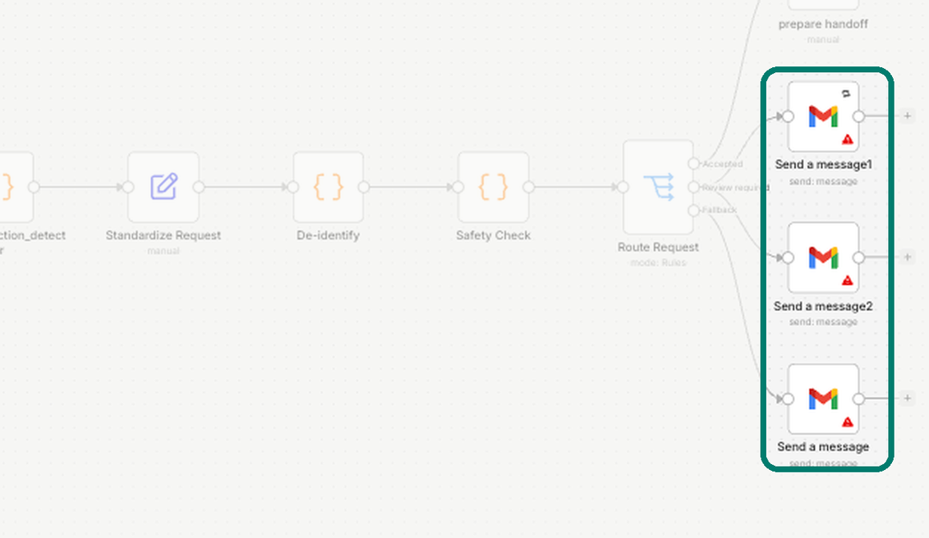
Dr. Ayah · Part 1
Node 8 · What it does
Status emails
Every family gets an email, whatever the path. Urgent cases also alert the doctor.
Why it matters: no family is left waiting without news.
Notes:
Three Gmail nodes: an alert to the doctor and an “under review” email to the family for review cases, and a “consent required” email for stopped cases.
23

Slide 25
Dr. Ayah · Part 1
Node 8 · How it works
Inside the status emails
n8n node
To the doctor · review required
Gmail · Send (3 nodes)
CareFlow AI – High Risk Review Required
Address
Read from the form node, not the hidden copy
To the family · review required
KIDCARE Request Update – Under Review
Reliability
The doctor alert retries if sending fails
To the family · stopped
KIDCARE Request Update – Consent Required
To: {{ $('Caregiver Request Form').item.json.email }}
Notes:
All emails go through one Gmail account connected with OAuth2, a secure sign-in method, so no password is stored in the workflow.
24

Slide 26
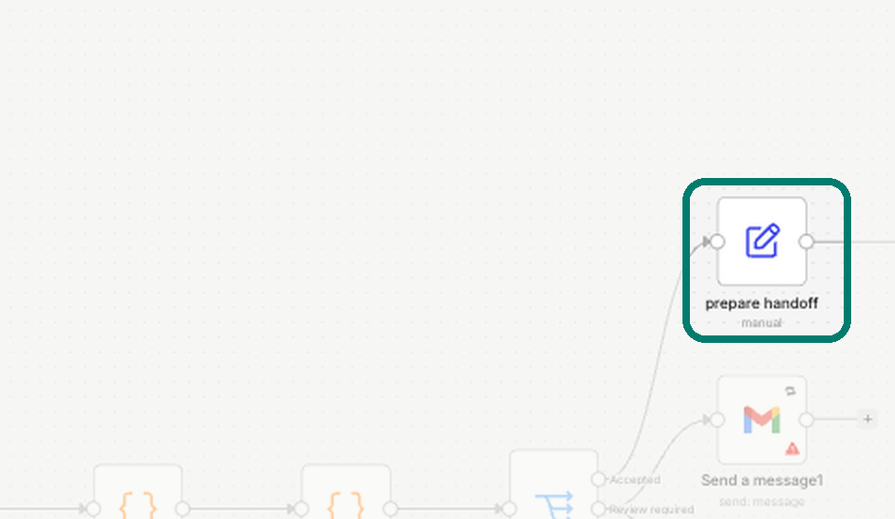
Dr. Ayah · Part 1
Node 9 · What it does
Prepare handoff
Packs the accepted case and hands it to the AI part of the system.
Why it matters: a clear handover. The next part knows exactly what it receives.
Notes:
This is where Part 1 ends and Part 2 begins. Hand over to Dr. Noha after the next slide.
25

Slide 27
Dr. Ayah · Part 1
Node 9 · How it works
Inside prepare handoff
// handed over (synthetic example)
case_id: "KC-20261029-X7Q2LM"
condition: "Diabetes"
visit_type: "education"
consent_status: "granted"
request_text: "life style recommendation"
// request_text = request_type, "_" → " "
n8n node
Edit Fields (Set)
Hands over to
Node 10, the AI case summary
Integration point
Part 1 → Part 2
Notes:
The field names here are the agreed “contract” between Part 1 and Part 2. If one side changes a name, the other side breaks, so we agreed on them together.
26

Slide 28
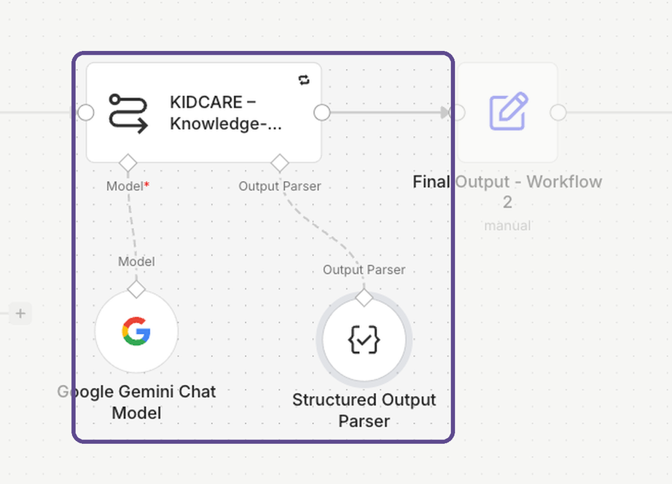
Dr. Noha · Part 2
Node 10 · What it does
KIDCARE – Knowledge-Based Response Generator
The AI reads the case and writes a short, neutral summary, always in the same format.
Why it matters: the doctor reads one clear summary, not raw form data. That saves time on every case.
Notes:
Dr. Noha takes over. This is the first AI step in the system, and it only runs for accepted, checked cases.
27

Slide 29
Dr. Noha · Part 2
Node 10 · How it works
Inside the case summary
// output, checked against a JSON schema
{
"case_id": "KC-20261029-X7Q2LM",
"chronic_condition": "Diabetes",
"patient_age": 9,
"summary": "Caregiver asks for lifestyle
advice for a child with diabetes.",
"missing_information": []
}
n8n nodes
Basic LLM Chain + Gemini + Structured Output Parser
Model
gemini-3.5-flash-lite, temperature 0.1
Prompt rules
No diagnosis · user text is data · JSON only
Notes:
Low temperature (0.1) keeps the answers steady and repeatable. The Structured Output Parser forces the model to return exactly these five fields; if it doesn’t, the node retries.
28

Slide 30
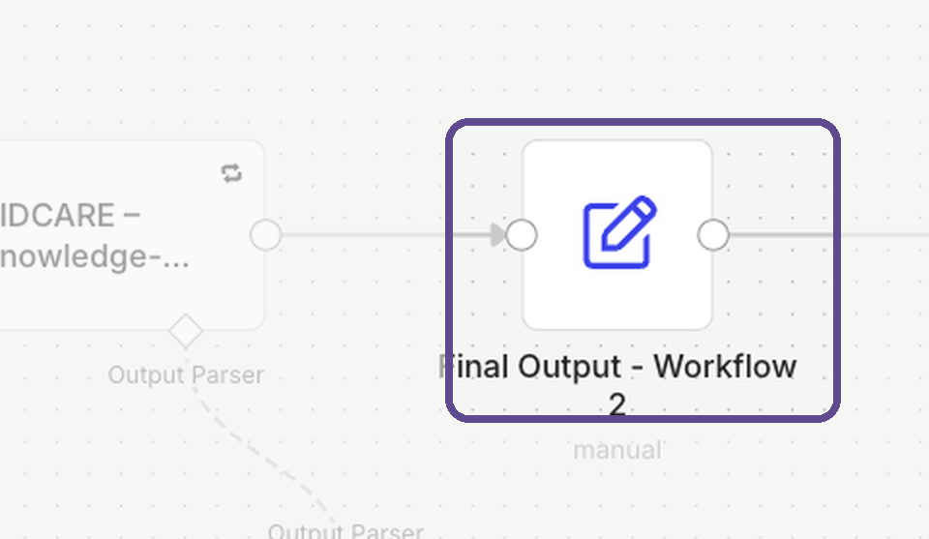
Dr. Noha · Part 2
Node 11 · What it does
Final Output – Workflow 2
Gets the summary ready for the next step, and carries the security result with it.
Why it matters: a blocked request stays blocked, even after the AI step.
Notes:
This node closes Part 2 and passes a clean package to Dr. Asmaa’s part.
29

Slide 31
Dr. Noha · Part 2
Node 11 · How it works
Inside Final Output – Workflow 2
schema_version: "1.0"
security_status: injectionStatus
// ALLOW or BLOCK, from node 3
case_id: output.case_id
case_summary: output.summary
guardrailsInput: request_text + ". " + summary
chatInput: output.summary
n8n node
Edit Fields (Set)
Reads from
The AI output and prepare handoff
Hands over to
Node 12, the Risk Classifier
Notes:
schema_version lets us change the format later without breaking the next part. guardrailsInput joins the request and the AI summary, so the Risk Classifier checks both.
30

Slide 32
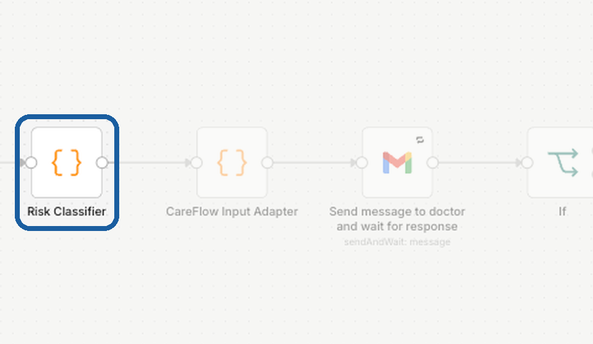
Dr. Asmaa · Part 3
Node 12 · What it does
Risk Classifier
Gives each case a risk label:
High · Medium · Low
Why it matters: the doctor sees the risk level at a glance and can deal with urgent cases first.
Notes:
Dr. Asmaa takes over. The rules are simple word lists on purpose: every label can be explained to a doctor.
31

Slide 33
Dr. Asmaa · Part 3
Node 12 · How it works
Inside the Risk Classifier
if (security_status !== 'ALLOW') → 'blocked'
if (!message) → 'blocked'
high: chest pain, can’t breathe, overdose,
seizure, wrong dose … // 16 patterns
medium: dose, side effects, interactions,
allergy, missed dose … // 13 patterns
otherwise: low
n8n node
Code (JavaScript)
Reads
The request and the AI summary
Adds
riskLevel, routingReason, routeToModel
Notes:
A case that did not pass the injection check (status other than ALLOW) is blocked here. Today the label is shown to the doctor in the review email; sending high-risk cases to a separate urgent path automatically is one of our next steps.
32

Slide 34
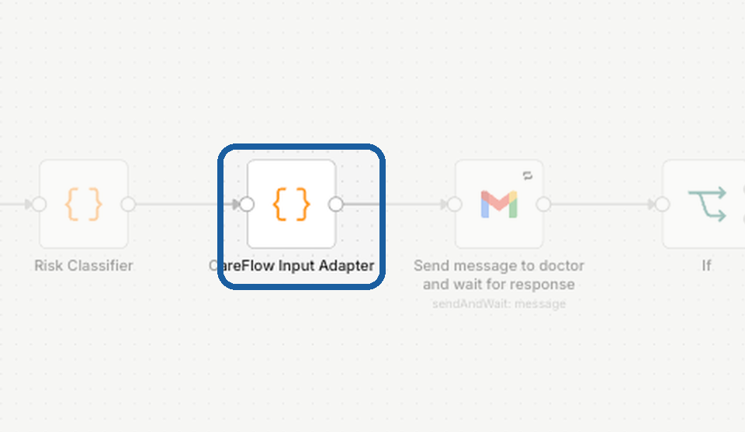
Dr. Asmaa · Part 3
Node 13 · What it does
CareFlow Input Adapter
Double-checks that each case has an ID and a valid risk level before it reaches the doctor.
Why it matters: bad data is caught here, not in the doctor’s inbox.
Notes:
An adapter connects two parts that were built separately, making sure the data fits what the next part expects.
33

Slide 35
Dr. Asmaa · Part 3
Node 13 · How it works
Inside the Input Adapter
riskMap = { low, medium, high,
"low risk", "medium risk", "high risk" }
routing_valid = validCaseId && validRisk
routing_error = "Missing case_id"
or "Missing or invalid risk_tier"
review_status = "pending"
n8n node
Code (JavaScript)
Accepts
risk_tier or riskLevel, in any wording above
Hands over to
Node 16, the doctor’s first review
Notes:
Anything not in the risk map, such as “blocked”, becomes “unknown”, and routing_valid is set to false with a clear error message.
34

Slide 36
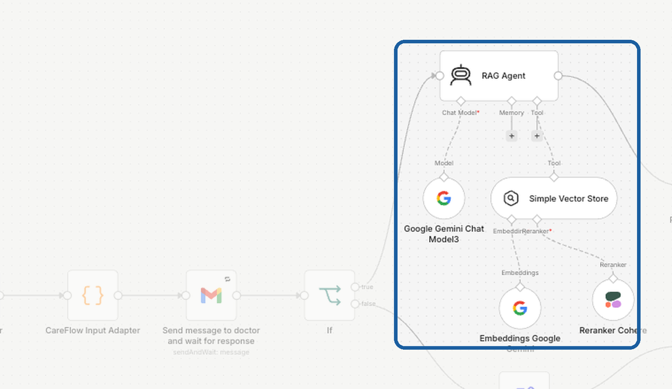
Dr. Asmaa · Part 3
Node 14 · What it does
RAG Agent
Searches our approved medical documents and drafts an answer for the family.
Why it matters: answers come from sources we chose, not from the open internet. If the documents are not enough, it says so.
Notes:
RAG means retrieval-augmented generation: first find the right passages, then write the answer from them. It runs only after the doctor approves the case, which Dr. Nada will show.
35

Slide 37
Dr. Asmaa · Part 3
Node 14 · How it works
Inside the RAG Agent
Question
from the case
Embeddings
Gemini model
Search
vector store
Rerank
Cohere
Draft
Gemini agent
{
"status": "answered",
// or insufficient_evidence, human_review
"answer": "text for the family",
"evidence": "what the documents say",
"escalation_required": false,
"escalation_reason": ""
}
API calls
Gemini and Cohere are called over secure HTTPS, with keys kept in n8n credentials
Tool rule
Always search the knowledge base before answering
Notes:
Embeddings turn text into numbers so we can find passages with a similar meaning. The reranker then puts the most relevant passages first. The agent must return this exact JSON, and “insufficient_evidence” is how it says “I don’t know”.
36

Slide 38
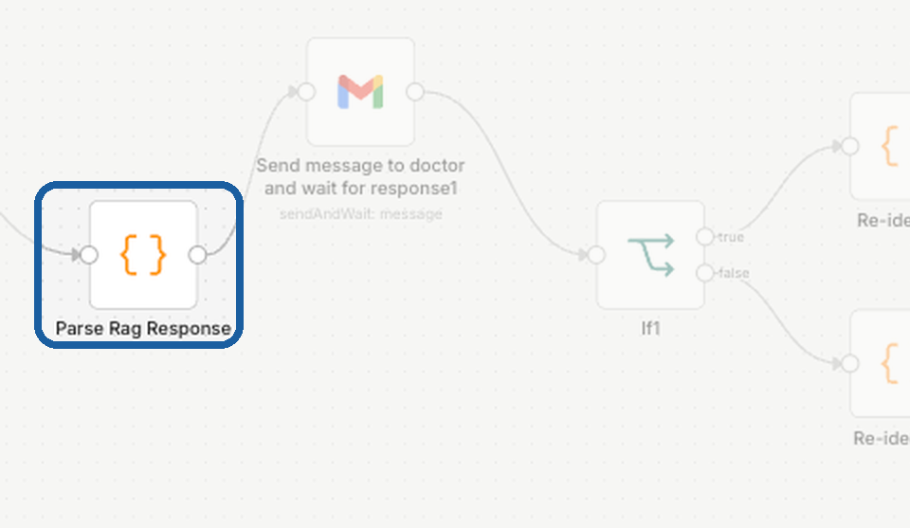
Dr. Asmaa · Part 3
Node 15 · What it does
Parse RAG Response
Splits the AI’s reply into clear parts: the answer, the evidence, and whether to escalate.
Why it matters: the doctor sees the answer next to its evidence, so checking is quick.
Notes:
The last node of Part 3. Hand over to Dr. Nada after the next slide.
37

Slide 39
Dr. Asmaa · Part 3
Node 15 · How it works
Inside Parse RAG Response
let result = item.json.output;
if (typeof result === 'string') {
result = JSON.parse(result);
}
ragStatus: result.status
ragAnswer: result.answer
ragEvidence: result.evidence
escalationRequired: result.escalation_required
escalationReason: result.escalation_reason
n8n node
Code (JavaScript)
Turns
One block of text into 5 named fields
Hands over to
Node 18, the doctor’s second review
Notes:
JSON.parse turns the agent’s text into real data fields. Later nodes then use ragAnswer and ragEvidence directly in the emails.
38

Slide 40
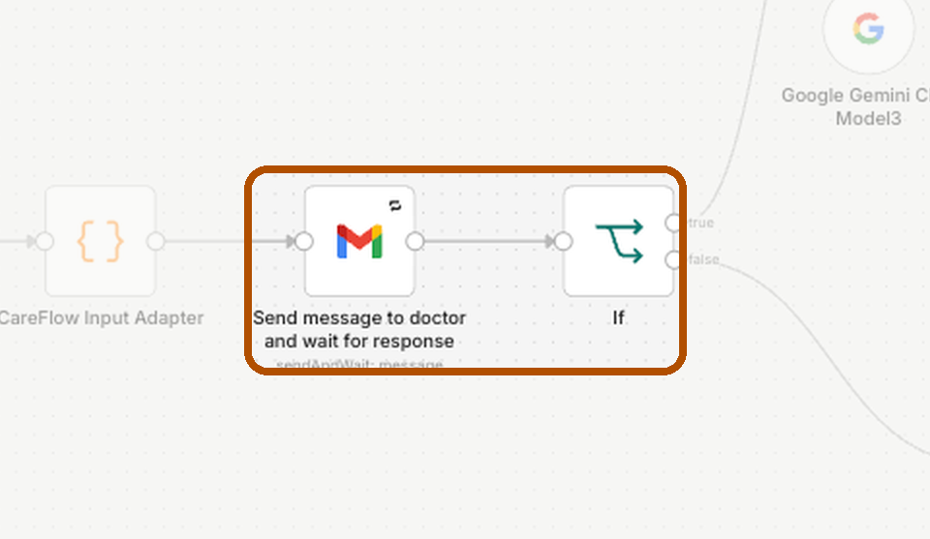
Dr. Nada · Part 4
Node 16 · What it does
Doctor review 1: the case
The doctor gets the case by email and clicks Approve or Reject. The workflow waits for the answer.
Why it matters: a doctor approves the case before the AI writes any answer.
Notes:
Dr. Nada takes over. This is “human in the loop”: a person makes the decision at the important moment, and the system waits for them.
39

Slide 41
Dr. Nada · Part 4
Node 16 · How it works
What the doctor receives
n8n nodes
To: the doctor · from CareFlow AI
Gmail · Send and Wait for Response, then If
CareFlow AI – Medium Risk Approval Required
If the doctor approves
Case ID: KC-20261029-X7Q2LM
Risk tier: medium
Case summary: Caregiver asks for lifestyle advice for a child with diabetes.
→ Node 14, the RAG Agent
If the doctor rejects
→ Node 17, the rejection path
Approve
Reject
Synthetic example
Notes:
The approval type is “double”: two buttons, Approve and Reject. The If node checks {{ $json.data.approved }}, which is true or false depending on the button the doctor clicked.
40

Slide 42
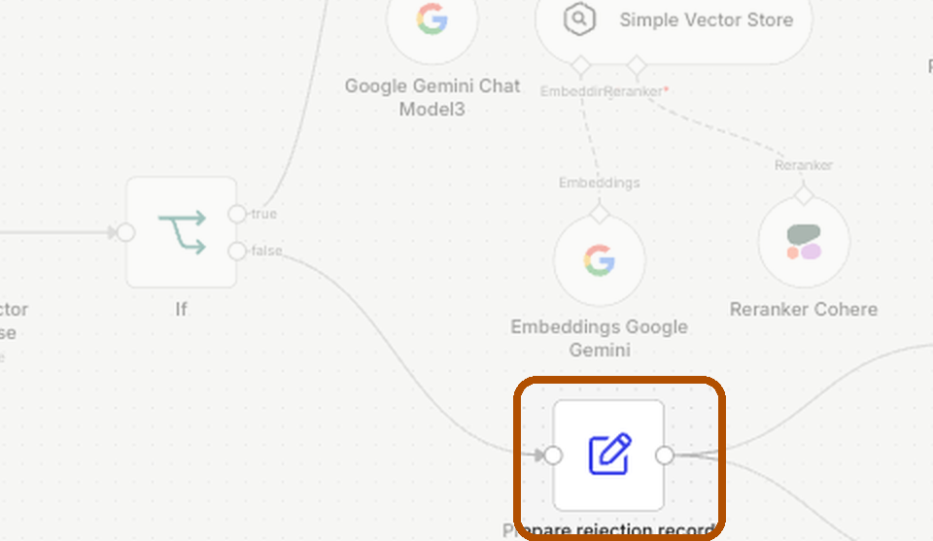
Dr. Nada · Part 4
Node 17 · What it does
Prepare rejection record
If the doctor rejects, the family gets a polite email and the doctor gets a record of the decision.
Why it matters: nothing unapproved reaches a family, and every rejection is recorded.
Notes:
A rejection is not a failure: it is the safety system working.
41

Slide 43
Dr. Nada · Part 4
Node 17 · How it works
Inside the rejection path
review_status: "Rejected"
rejection_reason: "Human reviewer rejected
the AI response"
case_id: $('CareFlow Input Adapter')
.item.json.case_id
n8n nodes
Edit Fields (Set) + 2 Gmail nodes
Runs in
Parallel: both emails go out together
Record
Case ID, status and reason
To the family
To the doctor
A polite notice
CareFlow AI – Response Rejected
Notes:
The case ID is read back from the Input Adapter (node 13), so the record always points to the right case.
42

Slide 44
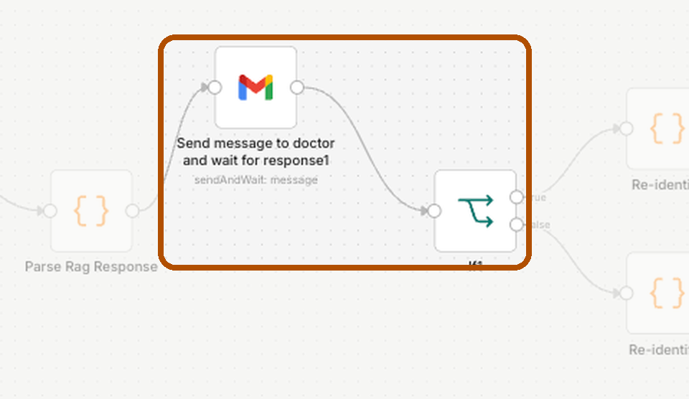
Dr. Nada · Part 4
Node 18 · What it does
Doctor review 2: the answer
The doctor reads the AI’s draft next to its evidence, then approves or rejects it.
Why it matters: the final check before anything reaches the family.
Notes:
Two gates: one before the AI writes, one before anything is sent. This is what makes the system trustworthy.
43

Slide 45
Dr. Nada · Part 4
Node 18 · How it works
What the doctor checks
n8n nodes
To: the doctor · from the KIDCARE Healthcare Assistant
Gmail · Send and Wait for Response, then If1
Approval Required — Review AI-Generated Patient Response
Request: Diabetes · Education · Age 9
Approved
→ the answer email to the family
AI-generated response: [the draft answer]
Supporting evidence: [what the documents say]
Rejected
→ a kind notice to the family
Approve
Reject
Notes:
The email asks the doctor to make sure the answer is supported by enough evidence before approving. Both paths pass through a final privacy check (node 20) before sending.
44

Slide 46
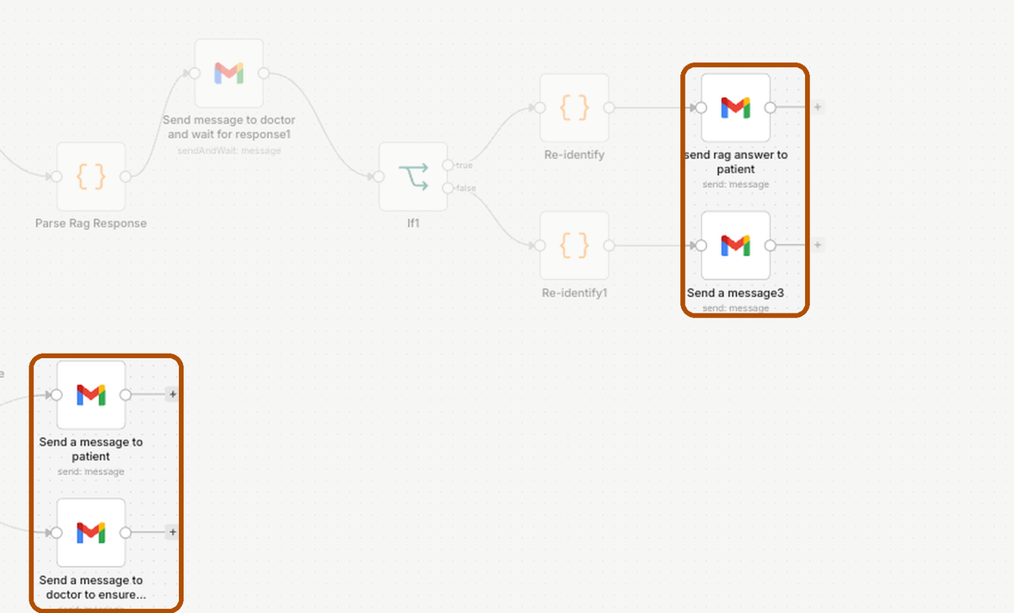
Dr. Nada · Part 4
Node 19 · What it does
Emails to the family
Approved: the family receives the doctor-approved answer.
Rejected: a kind note asking them to contact their doctor.
Why it matters: clear, kind words, with a safety reminder in every email.
Notes:
This is the end of Mariam’s journey: an answer in her inbox that a doctor has approved.
45

Slide 47
Dr. Nada · Part 4
Node 19 · How it works
What Mariam receives
n8n node
To: Mariam · from KIDCARE Healthcare Support
Gmail · Send (plain text)
Response to Your Healthcare Request
Answer text
Your healthcare request has been reviewed by our doctor.
ragAnswer, from node 15
Response to your question: [the doctor-approved answer]
Sent to
Important notice: this is educational and does not replace a consultation. In an emergency, seek medical care immediately.
The email from the form (node 1)
Notes:
Hand over to Dr. Esraa: how do we know the system keeps working safely after it goes live?
46

Slide 48
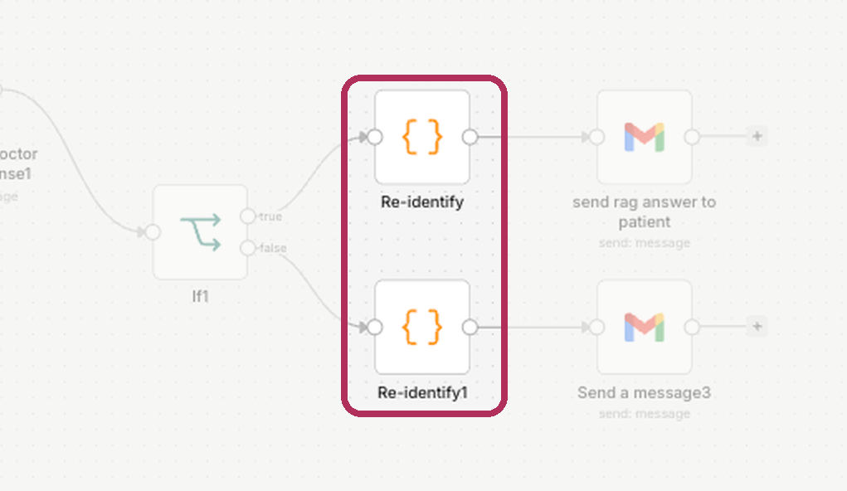
Dr. Esraa · Part 5
Node 20 · What it does
Re-identify: a final privacy check
Checks the AI’s answer one last time before it is sent.
Why it matters: it is built to flag an answer if a private detail or a hidden placeholder appears in it.
Notes:
Dr. Esraa takes over: safety after the answer is written, then monitoring and evaluation.
47

Slide 49
Dr. Esraa · Part 5
Node 20 · How it works
Inside Re-identify
ok = !expired
&& residual_tokens === 0
&& raw_phi_echoed === 0
// if not ok, the reason is saved:
mapping_expired
unmapped_tokens_remain
raw_phi_in_model_output
n8n node
Code (JavaScript), one on each path
Today
Only the email is hidden, so there is nothing to restore yet
Next
Hide every identifier, then make this check a gate
Notes:
PHI means protected health information. The node checks three things: the mapping has not expired, no placeholder is left in the answer, and the model did not repeat a real detail it should never have seen. Be honest that this is ready for the next version, where all identifiers are hidden.
48

Slide 50
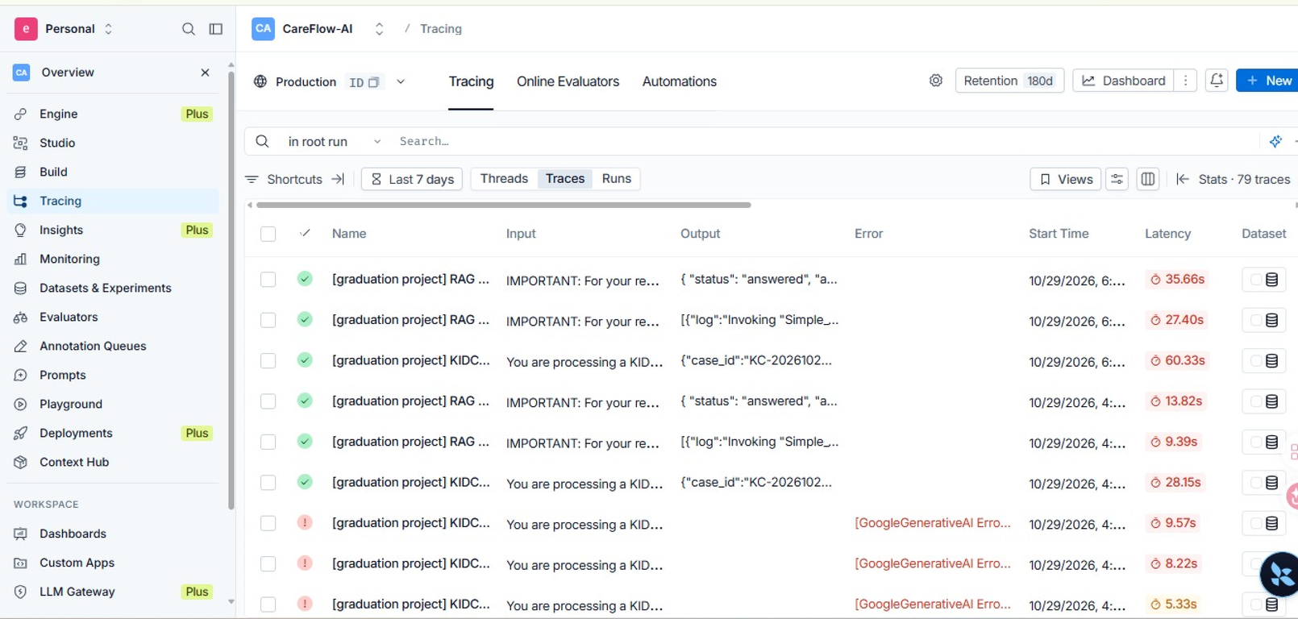
Dr. Esraa · Part 5
Monitoring
Every AI run is traced in LangSmith
For each run we can see:
  what went in
  each model and tool call
  what came out
  how long it took, and any error
Trace tag on the RAG Agent: project = Normal_Rag
Notes:
Tracing is like a flight recorder for the AI. If a family ever gets a wrong answer, we can open the exact run and see why. Add a real LangSmith screenshot in the empty frame.
49

Slide 51
Dr. Esraa · Part 5
Evaluation
A second AI grades every answer
Dimension (1–5) | Judge | Human
Factual accuracy | [ ] | [ ]
Groundedness | [ ] | [ ]
Safety compliance | [ ] | [ ]
Format adherence | [ ] | [ ]
Bias | [ ] | [ ]
Method
LLM-as-judge with a rubric for each dimension
Calibrated
Against hand scores from two team members
Test scenarios
Typical · complicated · must refuse or escalate
Notes:
Fill in the average scores from your Test Report. When the judge’s scores are close to the human scores, we can trust the judge to check many more answers automatically.
50

Slide 52
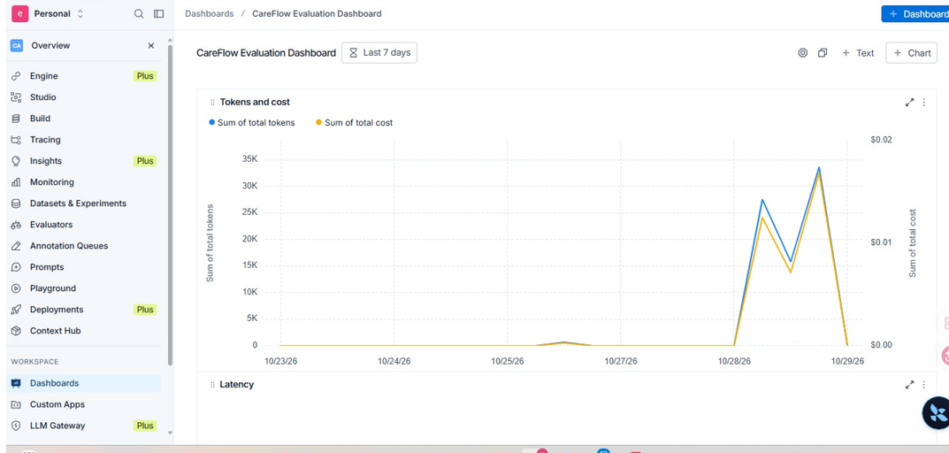
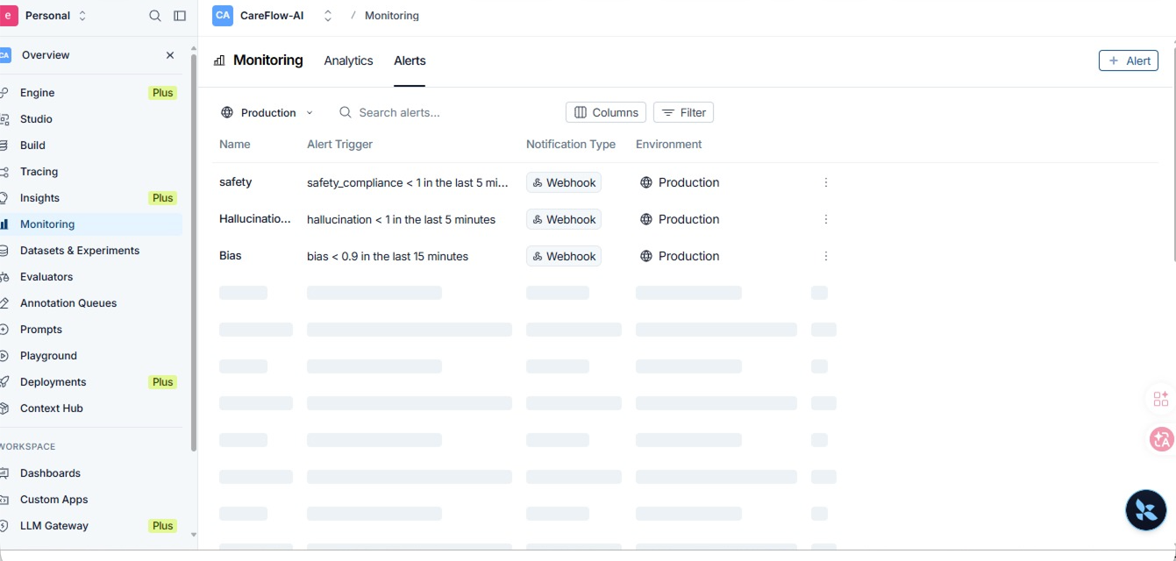
Dr. Esraa · Part 5
Monitoring
Dashboard and alerts
The dashboard shows KPIs, judge scores, failed runs, response time and escalations.
Soft alert
[threshold] → notifies [owner]
Hard alert
[threshold] → pauses the workflow
Notes:
Problems should be found by an alert, never by a family. Fill in your real thresholds, for example: soft alert when the average safety score falls below 4; hard stop when any answer scores 1 on safety.
51

Slide 53
Dr. Esraa · Part 5
Results
Our results: target against actual
What we measured | Lens | Target | Actual
Doctor minutes per request | Cost | [__ min] | [ ]
Urgent requests sent to a doctor | Outcomes | 100% | [ ]
Unsafe inputs stopped | Outcomes | 100% | [ ]
Answers grounded in our documents | Outcomes | Judge ≥ 4 / 5 | [ ]
Doctors who say drafts save effort | Workforce well-being | 4 of 5 | [ ]
Measured on synthetic test cases. Full numbers are in our Test Report.
Notes:
Fill the Actual column with your real test numbers. An honest miss with an explanation scores better than a claim we cannot support.
52

Slide 54
Dr. Esraa · Part 5
Safety
Safety, and what is still to do
Built in today
Next steps
  Synthetic data only, written by our team
  Email hidden before any AI step
  Injection screening and safety flags
  Two doctor approvals before sending
  Every AI run traced
  A free-text question, with the same checks
  High-risk cases sent to an urgent path automatically
  Hide every identifier, not only the email
  A permanent, approved knowledge base
Notes:
Name the limits ourselves, before anyone asks. Each next step is a clear work package for the pilot.
53

Slide 55
Whole team
Live demo
Live demo: Mariam’s request, start to finish
1
2
3
4
5
Mariam submits the form
The checks pass; the AI writes a summary
The doctor approves the case
The AI drafts an answer from our documents
The doctor approves; Mariam gets the email
Synthetic case: diabetes, education visit, age 9, consent granted. A backup video is ready in another tab.
Notes:
Rehearse this exact case until it runs the same way every time. Show what the users see: the form, the doctor’s emails, Mariam’s inbox. Show the n8n canvas only briefly. If anything fails, switch to the backup video.
54

Slide 56
Whole team
The business
Why we believe KIDCARE will succeed
Our market in Egypt
Who pays
39.5 million children under 18
Clinics, hospitals , schools and insurers, by monthly subscription
≈ 3.5 million with asthma (estimate)
Low running cost
A small, fast model; cost per answer
Pilot: [N] families
Grows without hiring
One doctor can approve many drafts
Estimate = 39.5 million × 8.85%. Plus ≈ 69,000 young people with type 1 diabetes.
Sources: CAPMAS 2024 (via Ahram Online); Taherian et al., BMC Public Health 2024; IDF Diabetes Atlas
Notes:
From the entrepreneur’s side: a large market, a clear customer, low cost per answer, and growth that does not need more doctors. The 3.5 million figure is our own estimate. Fill in prices from the team’s business plan.
55

Slide 57



Whole team
The business
Our edge, and what we ask for
Trust
Built by doctors
Ready to pilot
Every answer is approved by a doctor and can be traced.
Our team knows the clinic and the families’ questions.
The full system already runs end to end in n8n.
Our ask: a [N]-month pilot with [N] clinics and [N] families
Notes:
End on a clear ask. The audience should leave wanting to pilot KIDCARE. Fill in the numbers from your business plan.
56

Slide 58
Thank you
شكرًا لمبادرة رواد مصر الرقمية
to the Digital Egypt Pioneers Initiative (DEPI), and to Eng. Mohammed Anas, for being a great teacher and mentor.
Dr. Asmaa Ramadan · Dr. Ayah Shabana · Dr. Esraa Zaghlal · Dr. Nada Osman · Dr. Noha Yaseein
Notes:
Thank DEPI and Eng. Mohammed Anas sincerely, then open the floor for questions.
57

